Slide 1
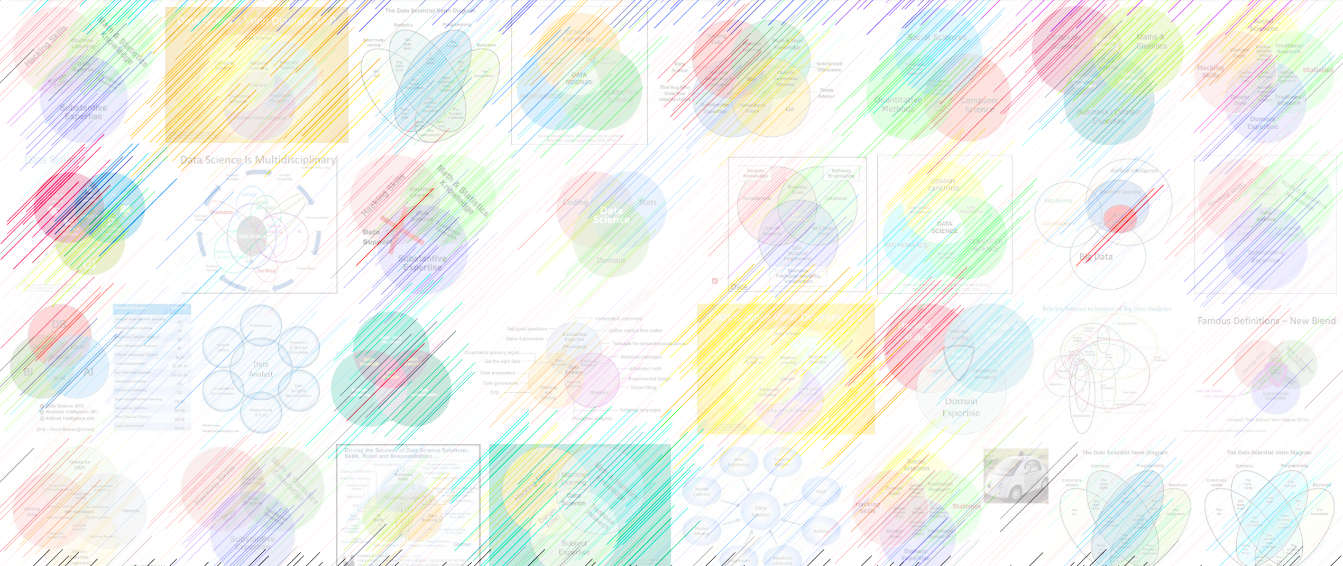

DATA221 Intro Machine Learning 07 logistic regression
William Trimble
Spring 2022

Slide 2
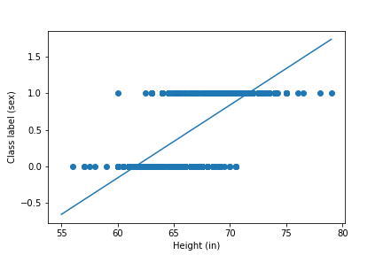
Linear regression on Galton height data
Linear regression on
indicator variables..
not the best we can do

Slide 3
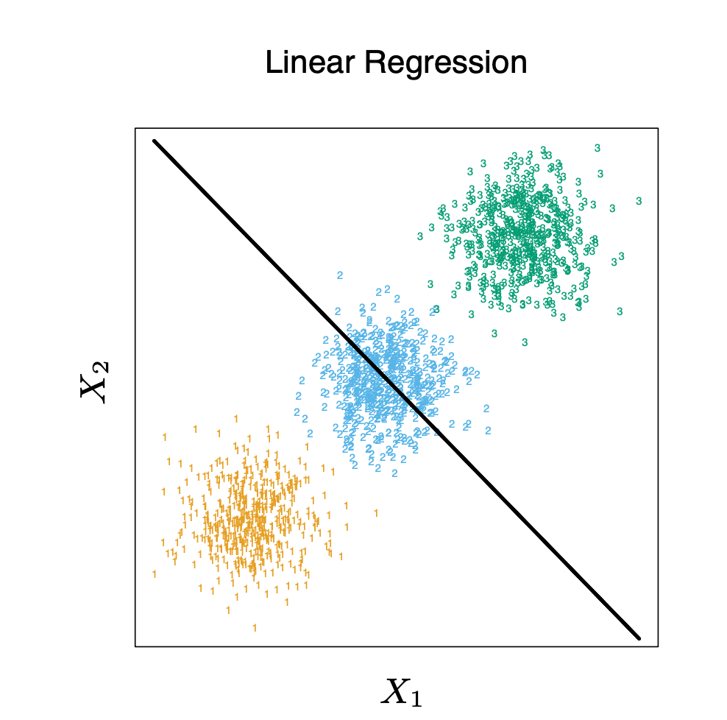

Slide 4
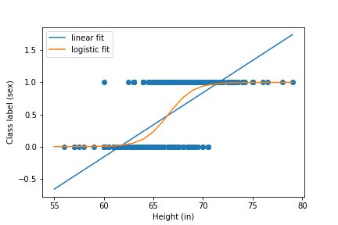
Logistic regression on Galton height data

Slide 5
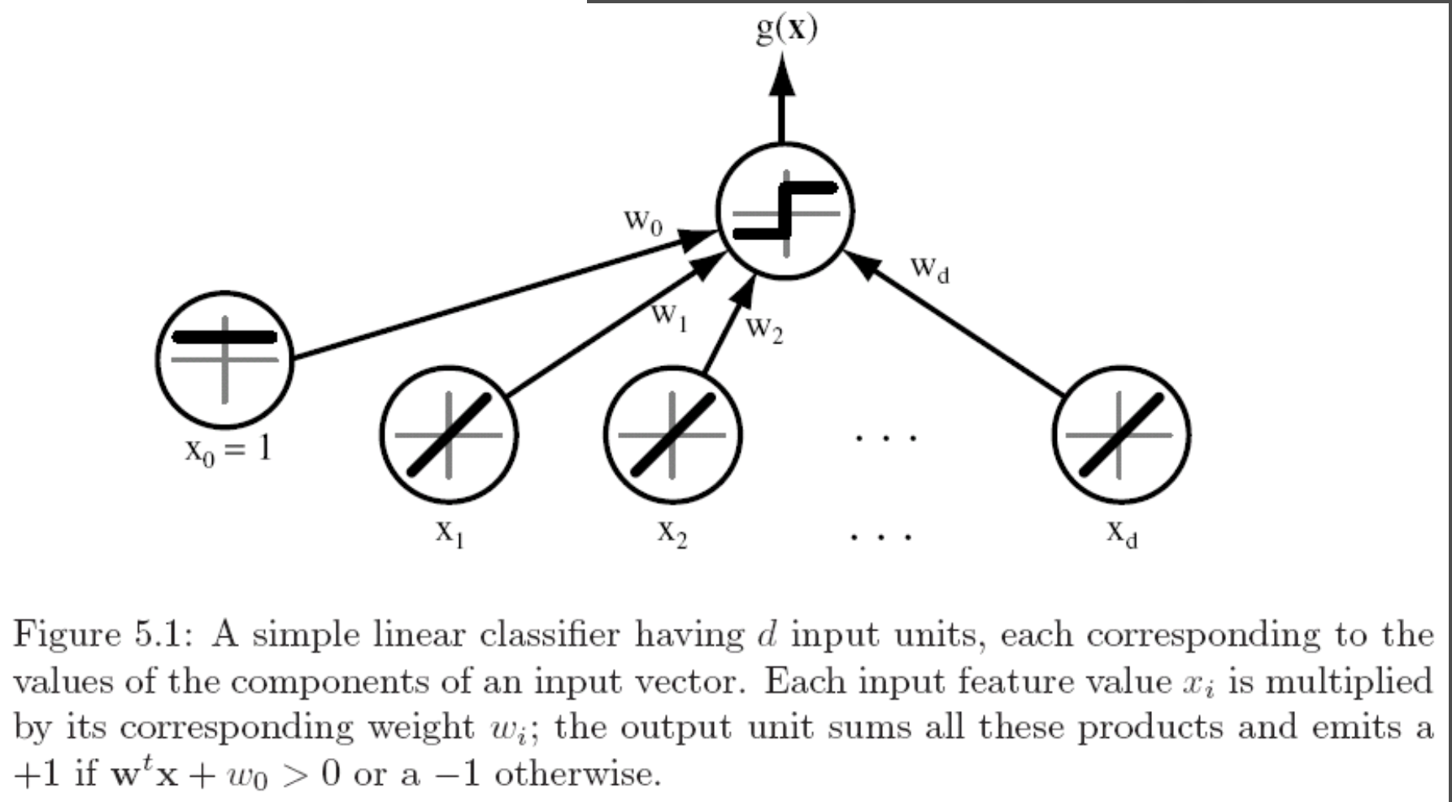
Linear classifier
Prediction(X, w) = g(w₀ + w^{T} X )
Nonlinear function; “activation function”
Duda, Pattern Classification

Slide 6
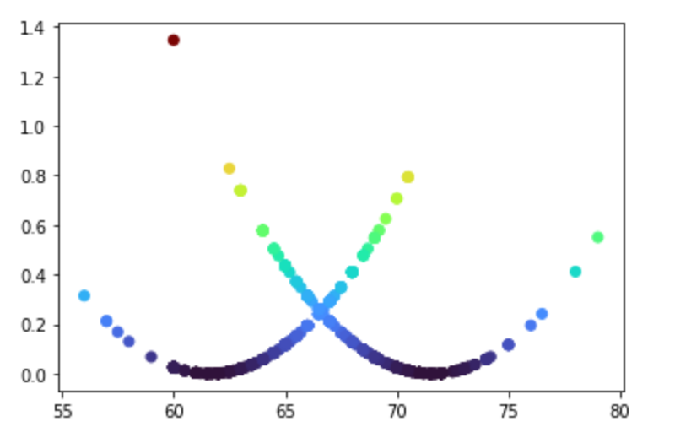
SSE loss function for Galton height data
SSE loss funciton
Height (in)

Slide 7
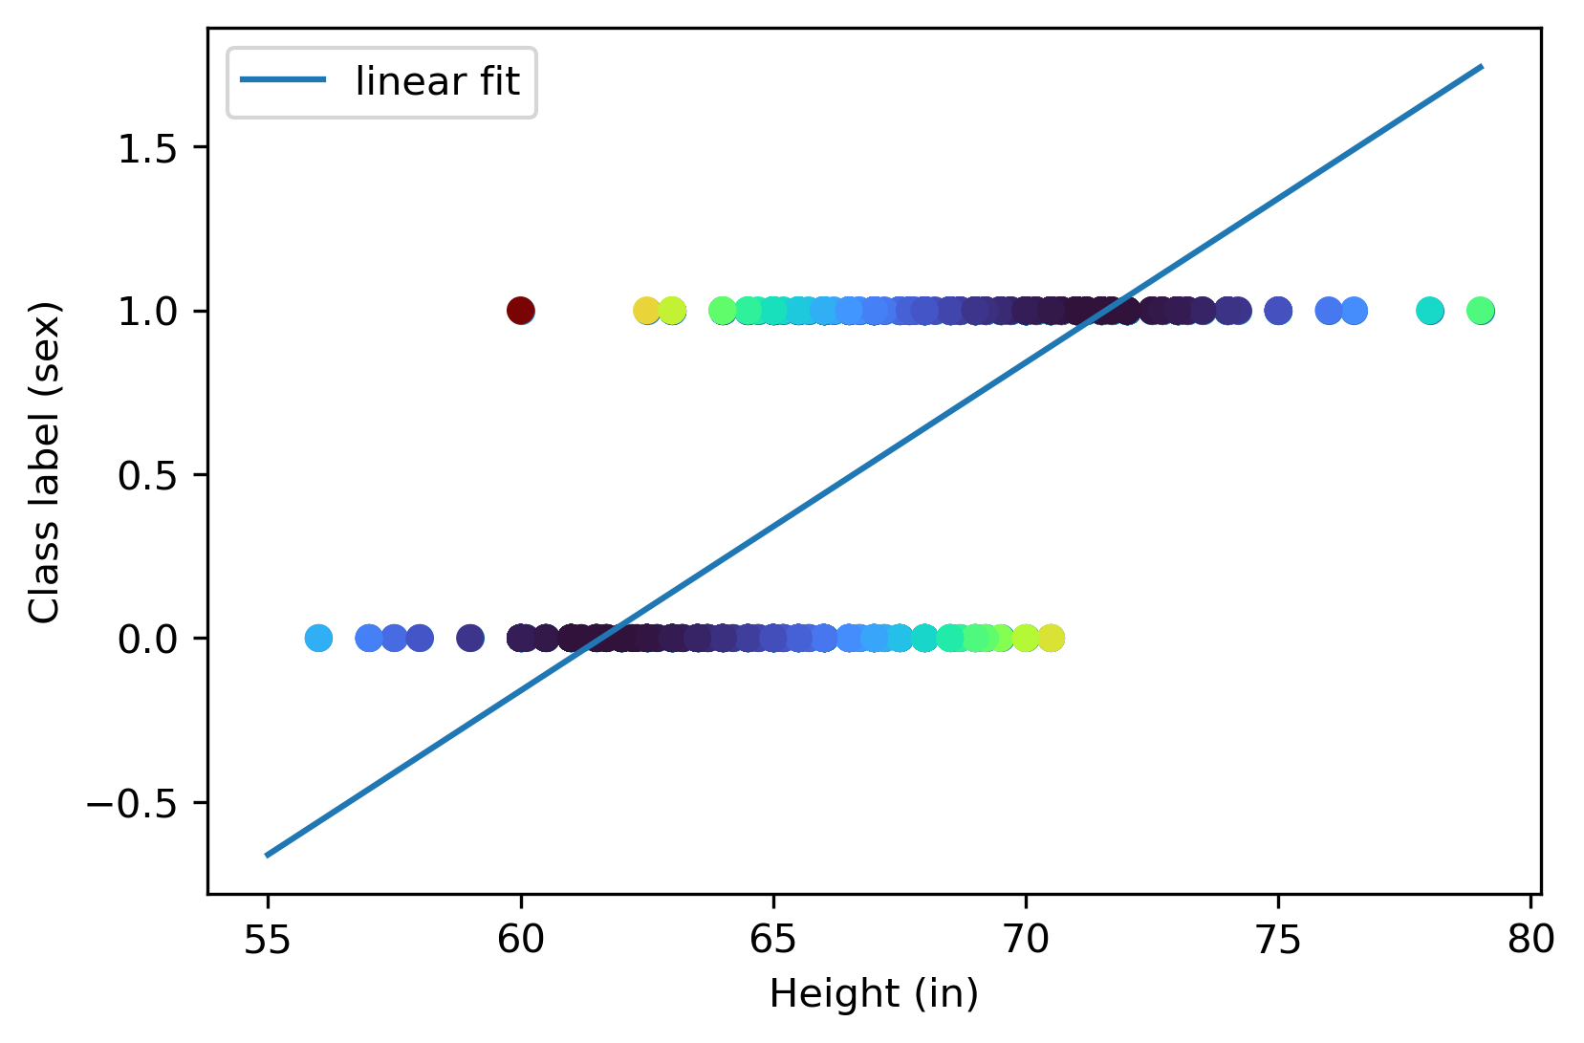
Linear regression on class label

Slide 8
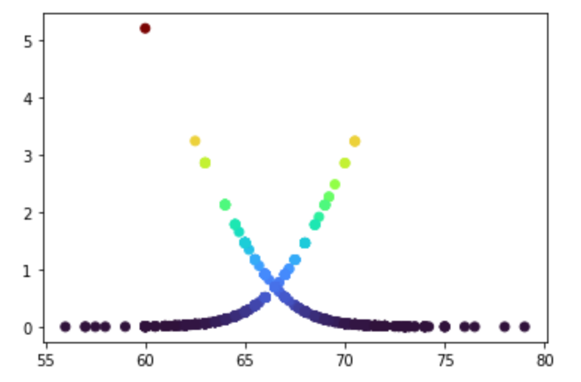
Logistic loss function on Galton height data
Logistic loss funciton
Height (in)

Slide 9
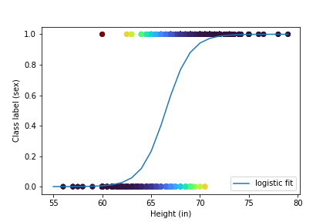
Logistic regression on class label

Slide 10
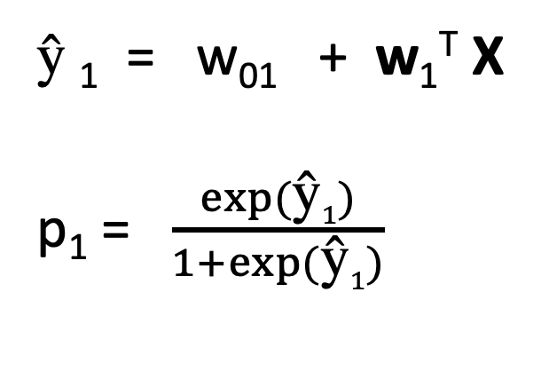
Logistic regression - ingredients
$\text{ŷ}$₁ = w₀₁ + w₁^{T} X
p₁ = $\frac{exp⁡(\text{ŷ}1)}{1+exp⁡(\text{ŷ}1)}$
Linear function of X
What are all these?

Slide 11
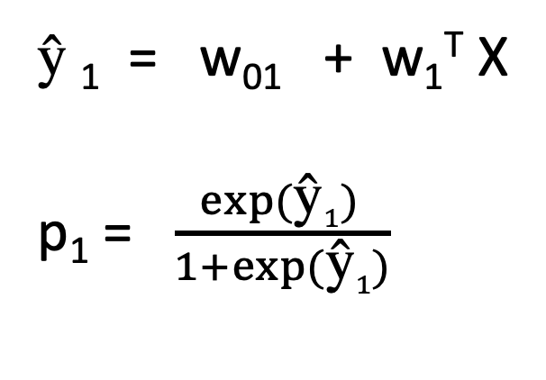
Logistic regression - ingredients
$\text{ŷ}$₁ = w₀₁ + w₁^{T} X
p₁ = $\frac{exp⁡(\text{ŷ}1) }{1+exp⁡(\text{ŷ}1)}$
Linear function of X
Limited to the range 0-1
Interpreted as a probability.
Why do I need two indices on the weights?

Slide 12
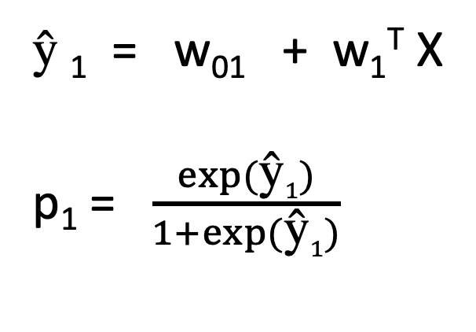
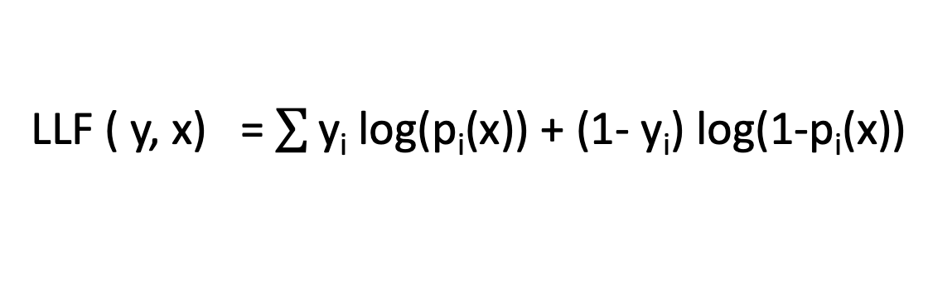
Logistic regression - ingredients
$\text{ŷ}$₁ = w₀₁ + w₁^{T} X
p₁ = $\frac{exp⁡(\text{ŷ}1)}{1+exp⁡(\text{ŷ}1)}$
Interpreted as a probability.
If y is true, log likelihood should be
log(p)
If y is false, log likelihood should be
log (1-p)
Logistic loss function
LLF ( y, x) = $\sum{\text{y}\text{i} \text{log}\text{(}\text{pi}\text{(}\text{x}\text{)) + }\text{(1- }\text{yi}\text{) }\text{log}\text{(1-}\text{pi}\text{(}\text{x}\text{))}}$
Here y represents my data, p my logistic predictions

Slide 13
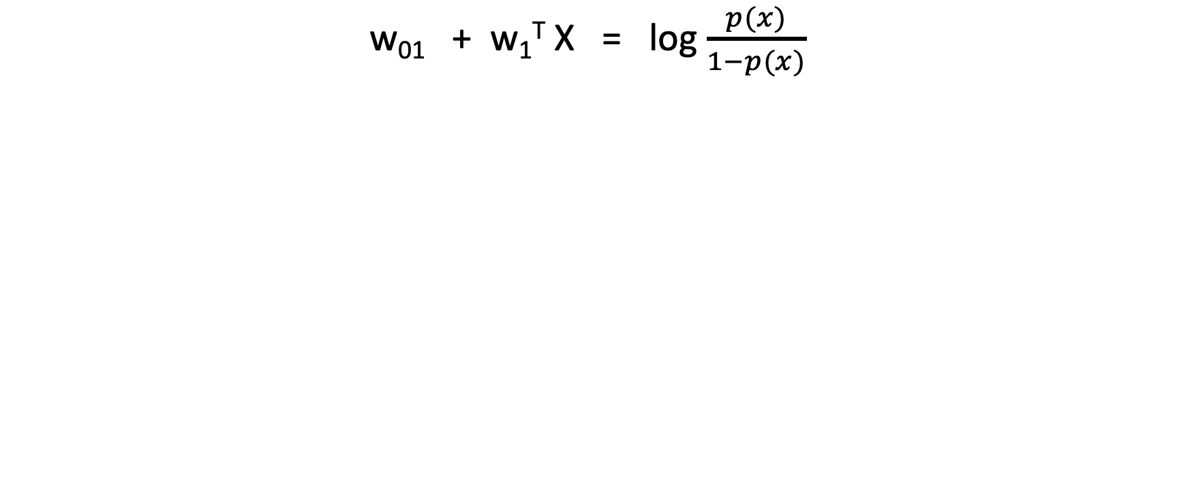
Odds interpretation of logistic function
w₀₁ + w₁^{T} X = log $\frac{p(x)}{1−p(x)}$
linear function of (multivariate) X
odds in favor of x
Why might someone like accounting in log-odds terms ?

Slide 14
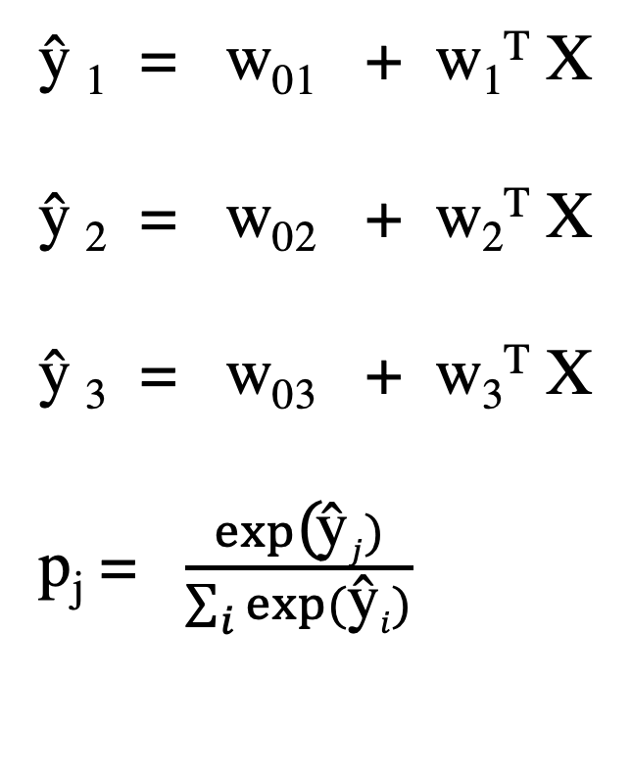
Generalize to estimate N probabilities
$\text{ŷ}$₁ = w₀₁ + w₁^{T} X
$\text{ŷ}$₂ = w₀₂ + w₂^{T} X
$\text{ŷ}$₃ = w₀₃ + w₃^{T} X
p_{j} = $\frac{exp\text{(}\text{ŷ}j)}{\sum_{i}{exp⁡(\text{ŷ}i)}}$

Slide 15
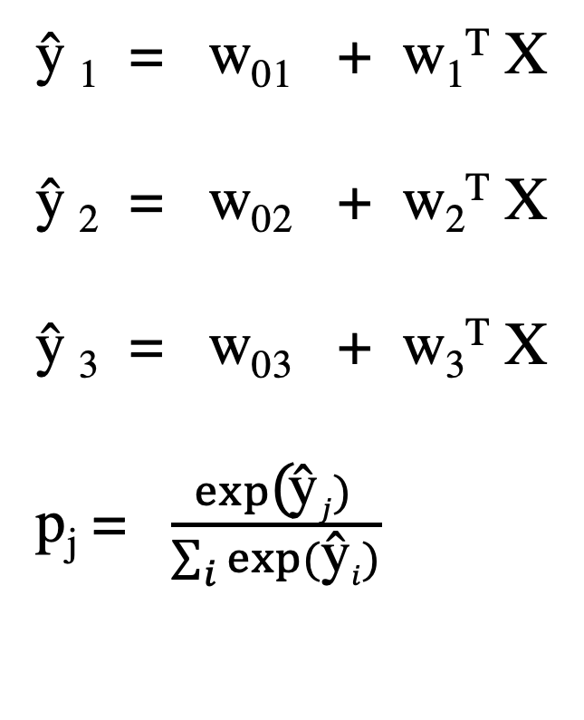
Generalize to estimate N probabilities
The class with the highest probability is
chosen as the predicted class label.
Since these are linear functions of X, the
decision boundaries are linear.
But, thankfully, the loss term pays more
attention to the boundary.
$\text{ŷ}$₁ = w₀₁ + w₁^{T} X
$\text{ŷ}$₂ = w₀₂ + w₂^{T} X
$\text{ŷ}$₃ = w₀₃ + w₃^{T} X
p_{j} = $\frac{exp\text{(}\text{ŷ}j) }{\sum_{i}{exp⁡(\text{ŷ}i)}}$

Slide 16
Naïve Bayesian Classifier
For classification (categories A, B, C given data D)
When you have a probability model for observations.
(Probability model is jargon for a set of outcomes and numbers for all their probabilities)
P(D|A) , P(D|B), and P(D|C) are known.
x ∈ {1, . . . , K} out of D kinds of observation
y = {1, . . . , C} out of C classes
θ_{c} = (prior) probaiblities of classes
p(x|y = c, θ) = 𝚷 p(x_{j} |y = c, θ_{jc})

Slide 17
Naïve Bayesian Classifier
Called naïve because the probabilities of the features are assumed to be independent.
What would correlated features generally do?
This is very much like our dice problem, and lends itself to simple bag-of-words models.
For classification (categories A, B, C given data D)
When you have a probability model for observations.
(Probability model is jargon for a set of outcomes and numbers for all their probabilities)
P(D|A) , P(D|B), and P(D|C) are known.
x ∈ {1, . . . , K} out of D kinds of observation
y = {1, . . . , C} out of C classes
θ_{c} = (prior) probaiblities of classes
p(x|y = c, θ) = 𝚷 p(x_{j} |y = c, θ_{c})

Slide 18
HW2
1 properties of bivariate normal.
2 PENGUINS linear regression, decision boundary
3 PENGUINS logisitic regression, decision boundary
4 PENGUINS quadratic decision boundary
5 PENGUINS classificiation/ confusion (any of the three above)
6 SPAM Score four messages for spam likelihood
7 SPAM Histogram of spam scores for the training corpus

